Slide 1
3-D Jewelry Creations
Erick Corona-Ramirez
Miguel Guzman Valle
Stephanie Gonzalez
Xue Feng
Yijing Cheng

Slide 2
Business Idea
Using the increase of use of Jewelry by people and those trying to get something that look nice at an affordable price. We can create a business that satisfy with those wants. The development of 3D printing has allowed of to created low cost and affordable product to the people. We not will only provide luxurious pieces but also affordable one that will make those who buy them be happy. One feature that will be available to customers is the request for custom designs. Customers can send their own design and have it custom made with materials that they want on it. With our only store location in Pasadena, CA.

Slide 3
Competition
With not a lot of people using or having a 3D Jewelry store front and showing how personal a piece of jewelry can be by customizing to meet the customers requirements. The uniqueness of this idea gives us the competitive advantage towards other jewelry stores.
Competitive Rivalry
Threat of New Entrants
Bargaining Power of Buyers
Threat of Substitutes
Bargaining Power of Suppliers
Threat of New Entrants:
Low to medium
Many people can open online business to offer 3D jewelry but, we can handle this by offering fast service and save on shipping
Competitive Rivalry:
Medium
There are a few online 3D Jewelry businesses and some people would rather online than go in person but, we can handle this by offering lower prices than online and letting the customer come in store if they need help designing.
Pugster Inc. would be one of our competitive rivals as they are basically doing what we are going to do. Although, the area in which we would be located is a bit different but, still they will have more history.
Bargaining Power of Buyers:
Medium to High
By providing a service in helping the customer design the piece of jewelry it will give us the advantage on either making the customer return or have them tell others.
Threat of Substitution:
Low
There is already a few 3D Jewelry stores online plus who knows if there might be some with a store front in other countries. But within the area of our location there isn’t as many.
Bargaining Power of Suppliers:
Low
The only suppliers needed will be the wax for the jewelry. We will have our own manager in charge of fixing the 3D Printers incase anything goes wrong.

Slide 4
Role of Information Systems
The use of information system will allow us to collect data and applying it by understanding the demographic information of what people spend their hard earn income. How much they spend in apparel/ accessories (jewels/jewelry). Get information about the competition and how they perform around that area. Collect data of the expenses require to maintain the business. The need of the clients and what they would prefer to see in the store.

Slide 5
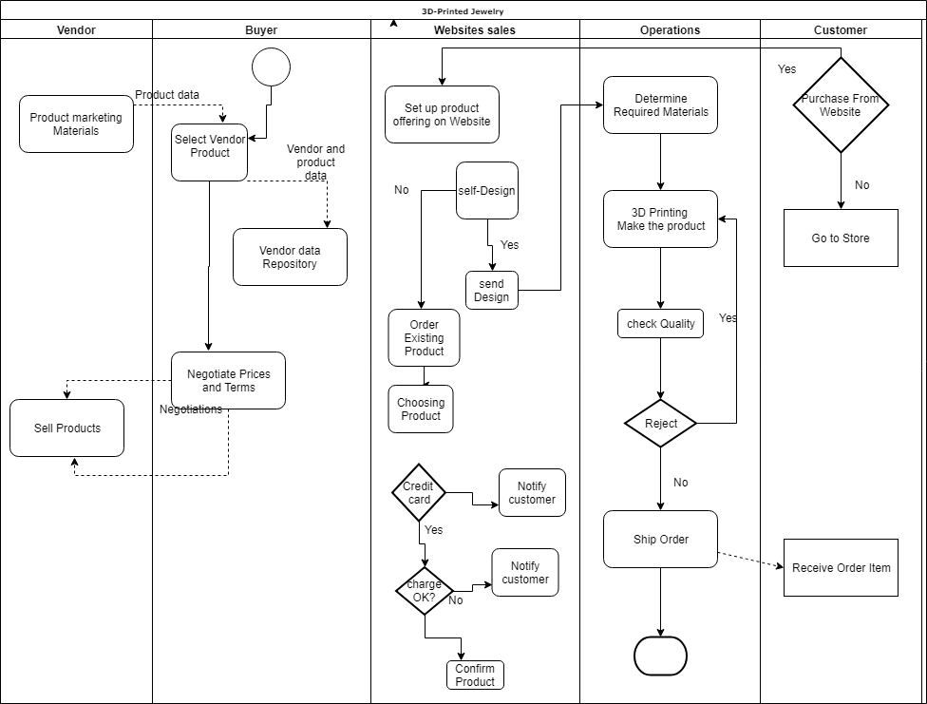
Role of Information Systems

Slide 6
Revenue
We will generate revenue through, up or down scaling the quality of the metals used in our jewelry. For example, if someone wants a ring since we 3-D print the Jewelry, depending on the customers’ need or want they can choose to have the rings band to be made from either silver, gold, or white gold on the spot. This allows us to reach a larger demographic of customers allowing us to generate high sales. Another way to generate revenue is if the customer wants to add either gems or diamonds to their jewelry they can then talk to our jewelers for a more personal and tailored experience when designing their jewelry, the way they want. By doing this it also allows us to reach the luxury market of jewelry to help generate revenue.
Lastly, we could provide customers to design their jewels form scratch and creating their one of a kind one will help providing more revenue. This would attract people that one to have something unquie.

Slide 7
Customers
Our mission is to provide good and reliable jewels and jewelry to all ages. That on itself it the main goal but, in specifics ages around 12+ years old would be our focus. Reason behind this would be because in the case of young people, they then to go with the fashion and trend of the moment. So, for them we can provide accessories that follow the current trend for and affordable price. For young adults and older besides the affordable designs, higher quality would be at their reach as well as the ability to request custom design unique to for the individual. Also, our target customers would mainly be in the middle- and high-income class as they are more lightly to spend their extra income in appeals and goods.

Slide 8
Location Analytics-I
Our Process for the GIS analysis was by looking with areas with high people traffic. As well with areas that are around people with high to medium disposable income. Also knowing where others Jewelry relates stores are located and find an area in which there is still high traffic of people while still keeping a good distance, so our business doesn’t overlap with the others.
The location of the store would be around Pasadena area near E Colorado Blvd, since that area is highly active and there’s a lot of commercial places around. It will attract people to the shops and those customers who are interested in jewelry would come into our shop out of curiosity and inspect our shop. Those who enter might purchase an item at the moment or might be interested to purchase later on.

Slide 9
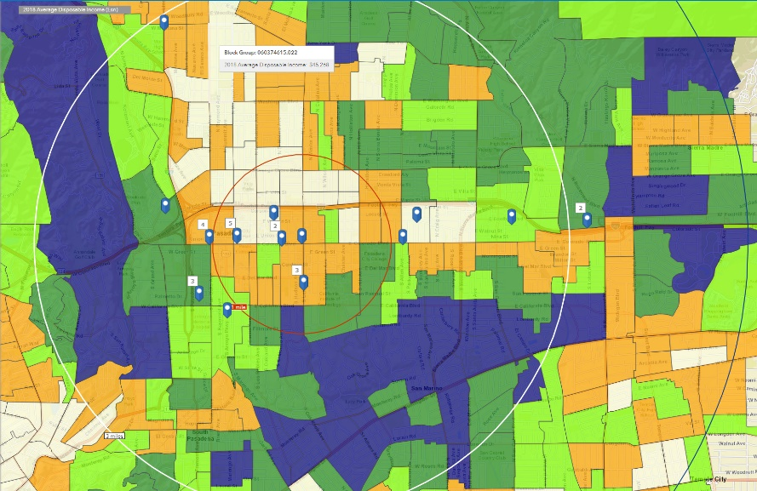
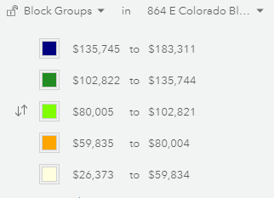
Location Analytics-II
Average Disposable Income

Slide 10
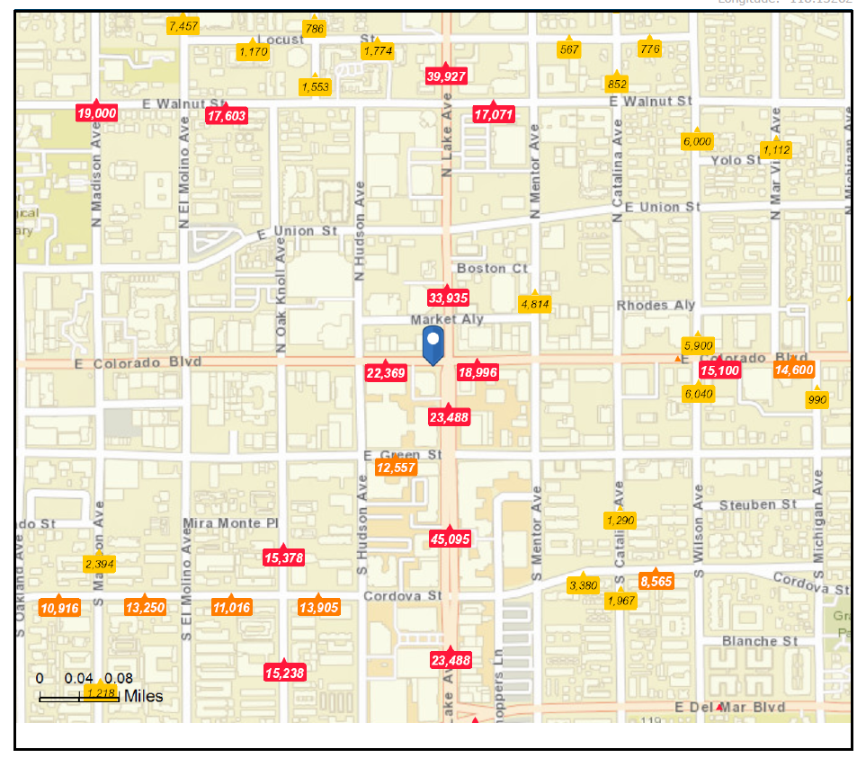
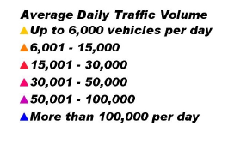
Location Analytics-III
The reason why we chose this location for the store is because of the high traffic of people around that area.

Slide 11
Location Analytics-IV
According to the first diagram, we could see that the areas with the average disposal income from $135,745 to $183,311 in 2018 is surrounded our location in the west and south. Also, on the second one, this location for the store has the high traffic of people around that area. By combining this two conditions, we believe that the high traffic situation would bring more and more people with high disposal income come to visit our store.

Slide 12
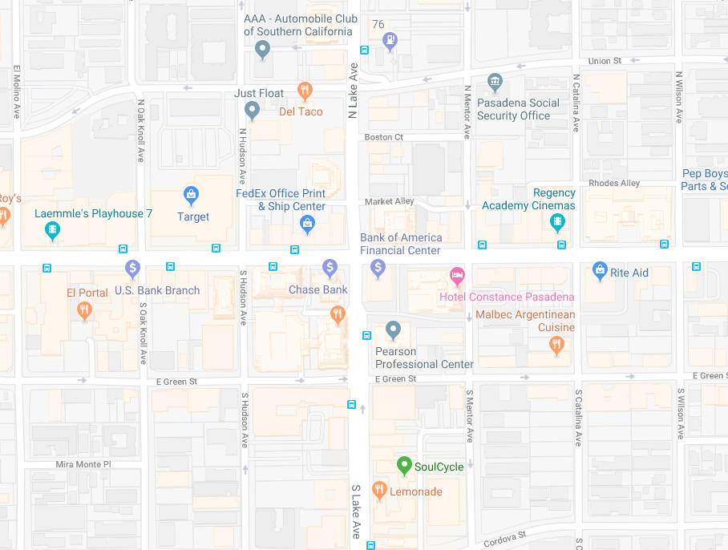
Location Analytics-V
Around - 864 E Colorado Blvd, Pasadena, California, 91101

Slide 13
Location Analytics- VI
According to the Tapestry report, there is over 50% of population satisfies our target customer's age in our location. Households of this location would increase by 580. The home value over $500K is 53%. Median Household Income is 4.45% The household income over $75K would keep increasing since 2018 to 2023. All of those categories show that we would have good prospects with this location.

Slide 14
Marketing Strategy
The marketing strategy will be base on attendance (promotion with a booth). Show part of the jewelry collection and advertise their value.
Used of website which will allow to increase visibility in the market, collect information and process orders.
Another option will be as the first one promotion using networks, art/jewelry galleries. Create relations with galleries that would be willing to exhibit some of the Stores pieces, which will allow people to know about the store and attract more customers.
The utilization of social media to look at our target demographic audience and promote through there to help attract more customers.

Slide 15
Messaging Strategy
We are a small Boutique Brand with a big Vision for the Future. Our goal as a company is to utilize bleeding edge technology to construct Beautiful Jewelry that can be customized base on the customers needs. We will achieve this by being Socially Responsible and avoiding Blood Diamonds and all other Humanitarian Crisis’

Slide 16
Are you going to be profitable?
According to analysts at the Retail Owners Institute, the gross margin percent trends for jewelry businesses have stayed relatively consistent in recent years. Gross profit margin is calculated by subtracting the cost of goods from a business's revenues. In 2013, the gross profit margin for jewelry stores was 43.5 percent. In 2017, it was 42.6 percent.
https://smallbusiness.chron.com/percent-profit-margin-retailers-expect-jewelry-73996.html

Slide 17
Conclusion
We can conclude that 3D-Printing jewelry would be successful.
With the use of 3D printers the ability that one has to created different designs with the use of different material. Use them as a base model to either improve on them or use them as mold for the final design. It facilitate and lower the cost of creating models for the final product.
At the same time with the using of 3D modeling one can create as many and unique designs that would attract customers and people in general to the store. The increase on customers satisfaction would help with the increase of the business reputation and that would lead to the increase on the business in general.

Slide 18
Three Wows
We found interesting the profit margin that Jewelry stores get.
Interestingly there are not many moving in providing and using 3-D printing technology for helping create the base of jewels or even using them.

